Slide 1

Data Analytics on Short-Term Rentals: A Case Study of NYC Airbnb
VIDYADHEESHA M PANDURANGI
Internship ID: INTERNSHIP_172663295366ea53f910591
AICTE STUDENT REGISTRATION ID: STU667711a678b251719079334

Slide 2

PROBLEM STATEMENT
The hospitality industry has undergone a significant transformation with the rise of online platforms facilitating short-term lodging and tourism. Leading this revolution is Airbnb, ., a pioneering American company that has reshaped travel accommodation through its innovative online marketplace. Established in 2008 in San Francisco, California, Airbnb provides a diverse range of lodging options, offering guests a unique and personalized experience. Unlike traditional hospitality providers, Airbnb operates on a commission-based model, facilitating transactions between hosts and guests without owning the properties listed on its platform.
This research analysis delves into the New York City Airbnb dataset to extract meaningful insights. Through rigorous data cleaning, exploratory analysis, and visualization techniques, the study aims to illuminate the dynamics of the city’s lodging market. By discerning factors influencing listing availability, pricing strategies, and overall customer satisfaction, the research contributes to a deeper understanding of Airbnb’s operations in one of the world’s most dynamic urban environments. These insights hold significance for stakeholders and enthusiasts seeking to navigate the evolving landscape of short-term accommodation.

Slide 3
This project focuses on analyzing the New York City Airbnb dataset to uncover patterns, trends, and insights that shape the dynamics of the short-term lodging market. The primary objective is to transform raw Airbnb data into actionable knowledge through systematic data preprocessing, exploratory data analysis (EDA), and visualization techniques. The project begins with data cleaning to handle missing values, remove inconsistencies, and ensure the dataset’s integrity. Following this, exploratory data analysis is conducted to examine key variables such as listing availability, host activity, pricing structures, property distribution, and customer preferences. Various visualization tools and statistical techniques are employed to highlight relationships between factors such as neighborhood popularity, seasonal trends, price variations, and review scores. In addition, the project explores pricing strategies by identifying factors that significantly influence listing prices, such as location, room type, and host experience. It also examines customer satisfaction indicators by analyzing reviews and ratings to better understand guest expectations. The outcomes of this analysis provide valuable insights for hosts (to optimize pricing and improve occupancy rates), guests (to make informed lodging choices), and policy makers (to understand the socio-economic impact of Airbnb in urban areas). By the end of the project, the analysis not only offers a deeper understanding of Airbnb’s operations in New York City but also demonstrates the power of data-driven approaches in evaluating the evolving landscape of the hospitality industry.
PROJECT DESCRIPTION

Slide 4

WHO ARE THE END USERS?
Airbnb Hosts
To optimize pricing strategies and increase occupancy rates.
To understand customer preferences and improve guest experience.
Guests / Travelers
To make informed lodging decisions based on price, availability, and reviews.
To identify the best neighborhoods and property types for their stay.
Airbnb as a Company
To analyze market trends and improve platform recommendations.
To enhance customer satisfaction and increase platform engagement.
Researchers & Data Analysts
To study patterns, trends, and socio-economic impacts of short-term rentals.
To use the dataset for testing and validating analytical or machine learning models.
Policy Makers & Urban Planners
To assess the impact of short-term rentals on housing, tourism, and local communities.
To guide policy formulation for sustainable urban development.

Slide 5

TECHNOLOGY USED
Jupyter Notebook
Provides an interactive environment for coding, data analysis, and visualization.
Supports step-by-step execution, making it ideal for exploratory data analysis (EDA).
Python Libraries
NumPy (numpy as np)
Used for numerical computations and handling multi-dimensional arrays.
Provides mathematical functions for efficient data manipulation.
Pandas (pandas as pd)
Used for data cleaning, transformation, and manipulation.
Provides DataFrame and Series structures for handling structured datasets.
Matplotlib (matplotlib.pyplot as plt)
Fundamental library for creating static visualizations.
Useful for line charts, bar graphs, histograms, and scatter plots.
Seaborn (seaborn as sns)
Built on top of Matplotlib, designed for statistical data visualization.
Helps create more informative and attractive plots like heatmaps, boxplots, etc.
Plotly Express (plotly.express as px)
Used for creating interactive visualizations.
Enables dynamic charts and dashboards for deeper data insights.

Slide 6
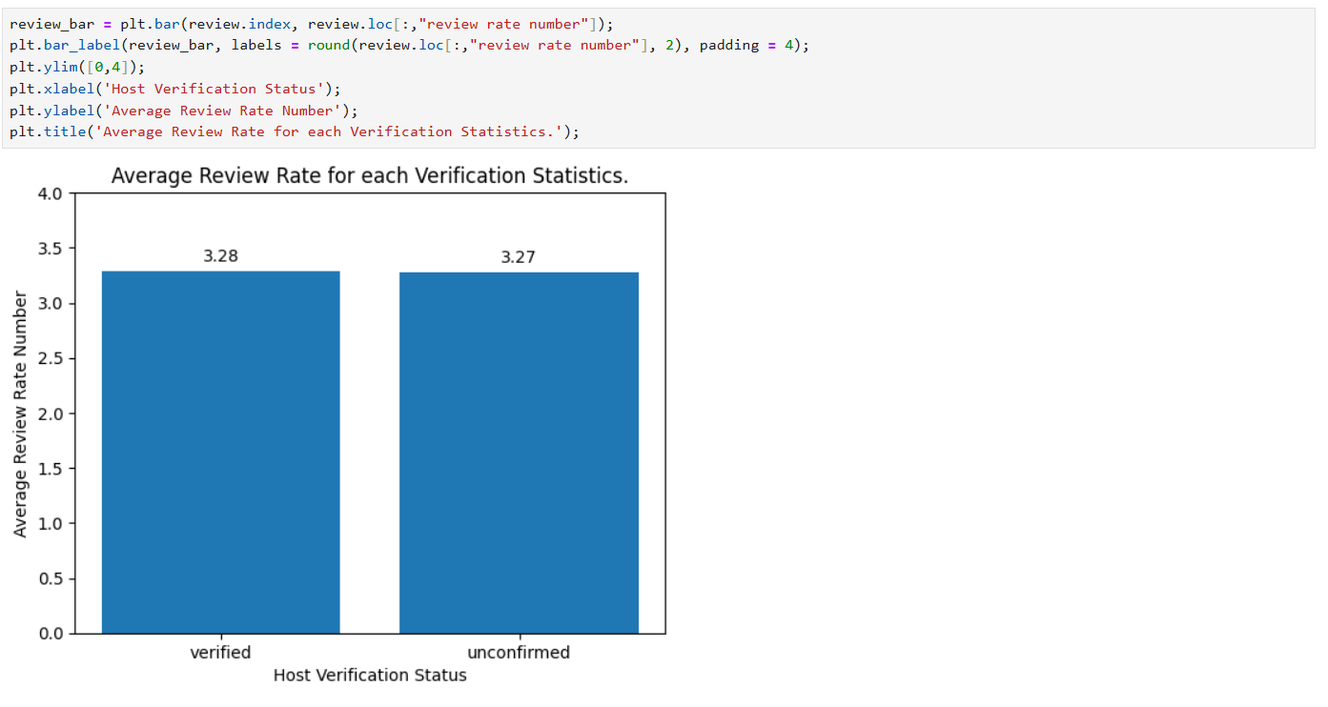
RESULT - 01
Fig: 01 – Plot of Average Review Rate for each Verification Statistics

Slide 7
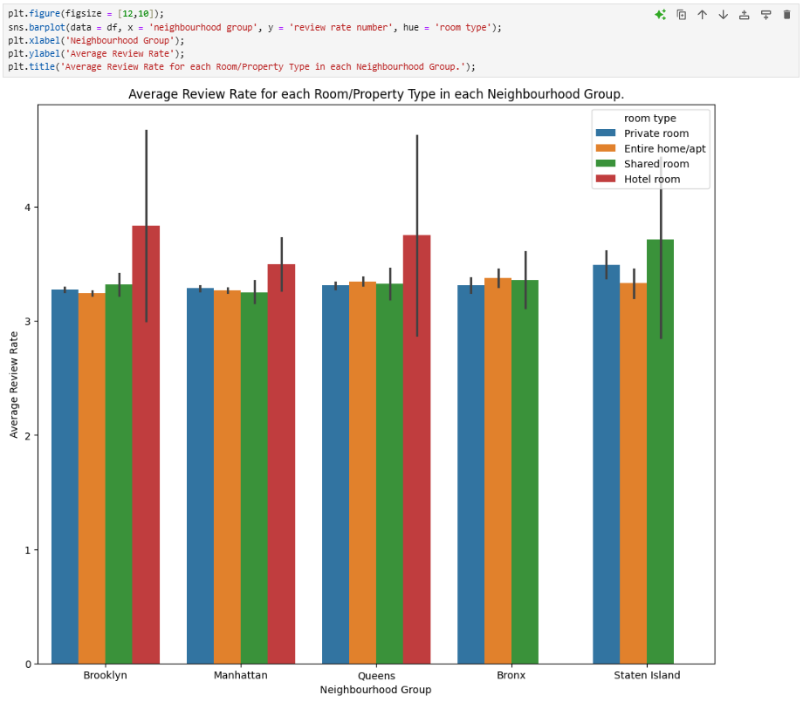
RESULT - 02
Fig: 02 – Plot of Average Review Rate for each Room/Property Type in each Neighbourhood Group

Slide 8
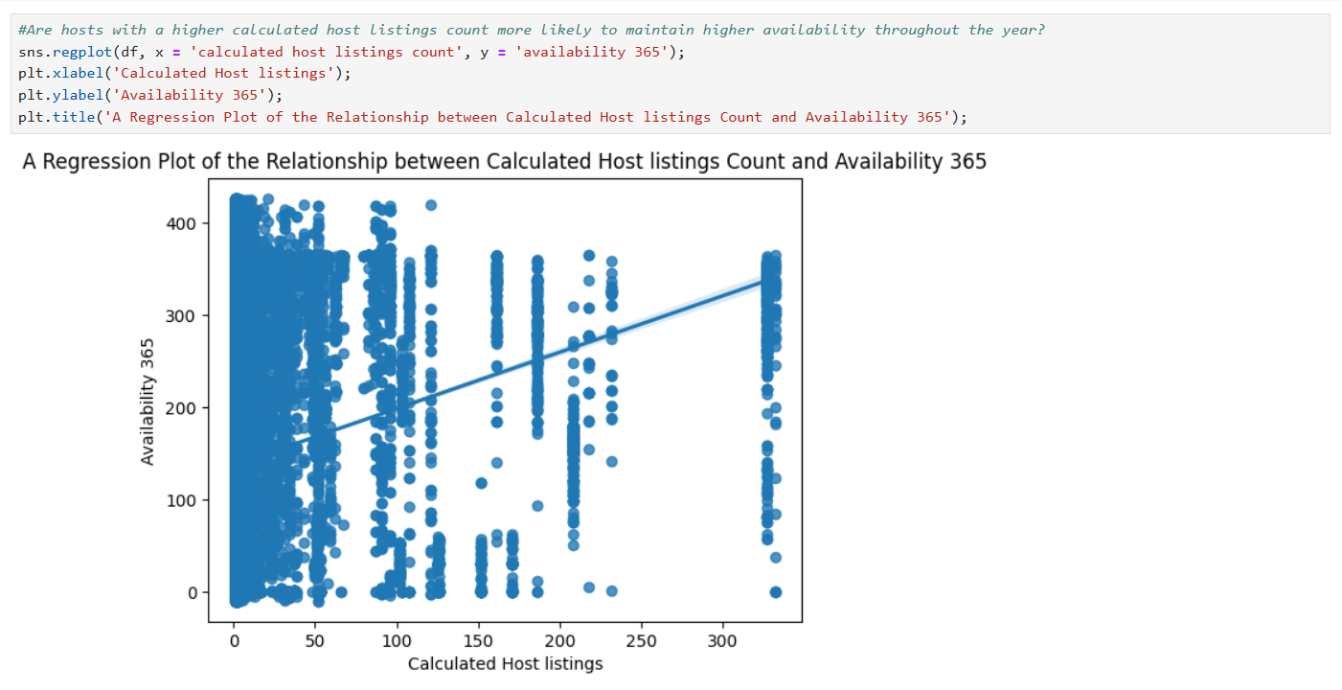
RESULT - 03
Fig: 03 - Plot of the Relationship between Calculated Host listings Count and Availability 365

Slide 9
GITHUB REPOSITORY
GitHub Link:
https://github.com/Vidyadheesha-M-Pandurangi/VOIS_AICTE_Oct2025_Vidyadheesha_M_Pandurangi.git

Slide 10

GETTING STARTED WITH BASICS OF PYTHON CERTIFICATE

Slide 11
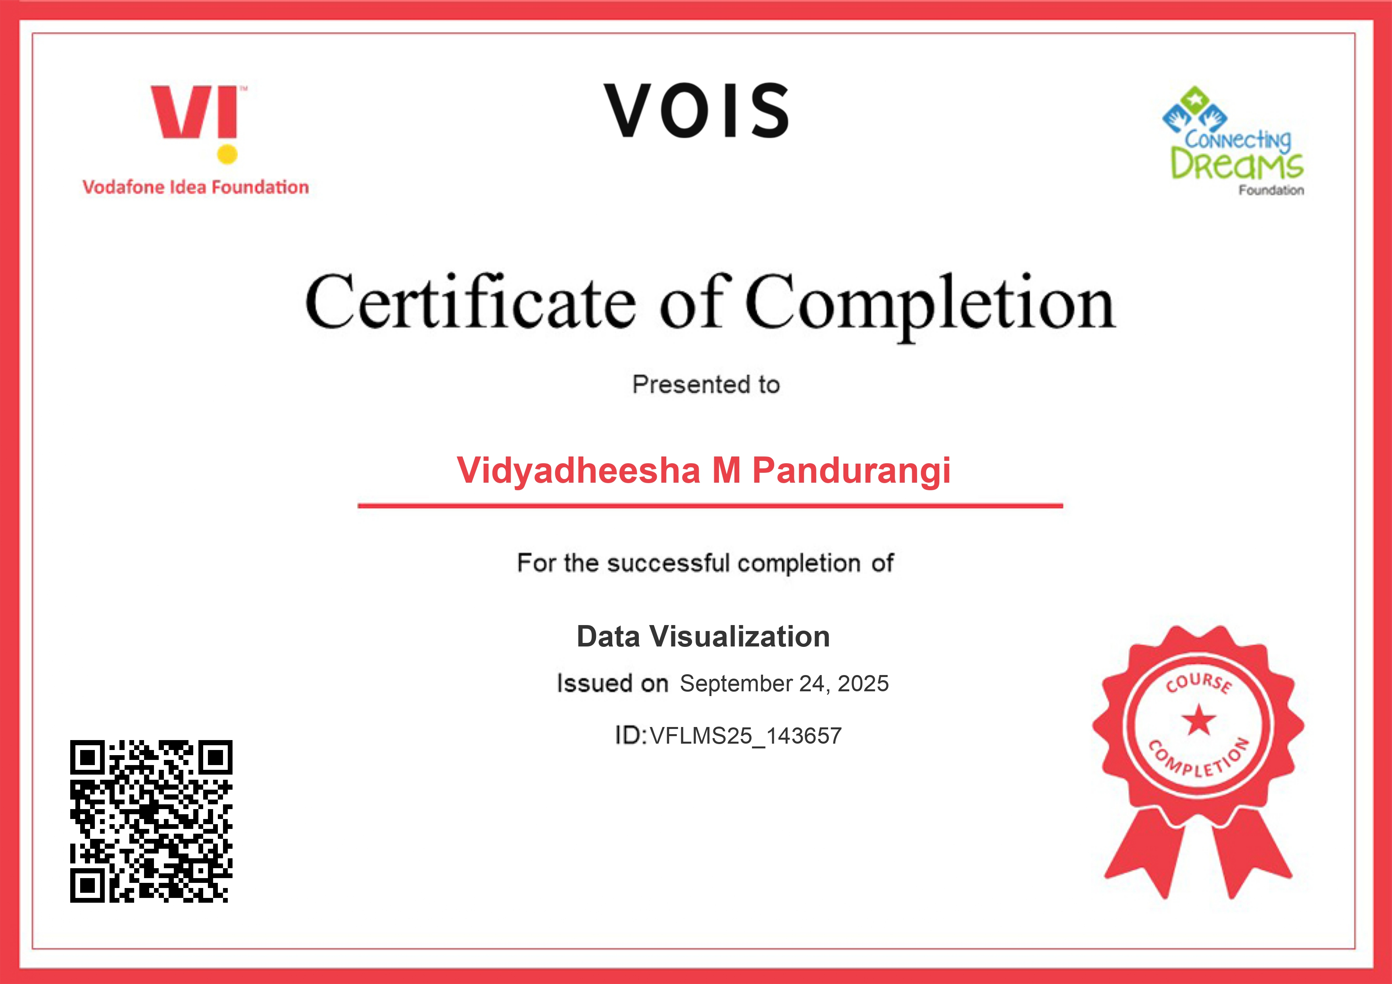
DATA VISUALIZATION CERTIFICATE

Slide 12
THANK YOU
.

